Slide 1









STUDENT INTERESTS SYSTEM

Slide 2

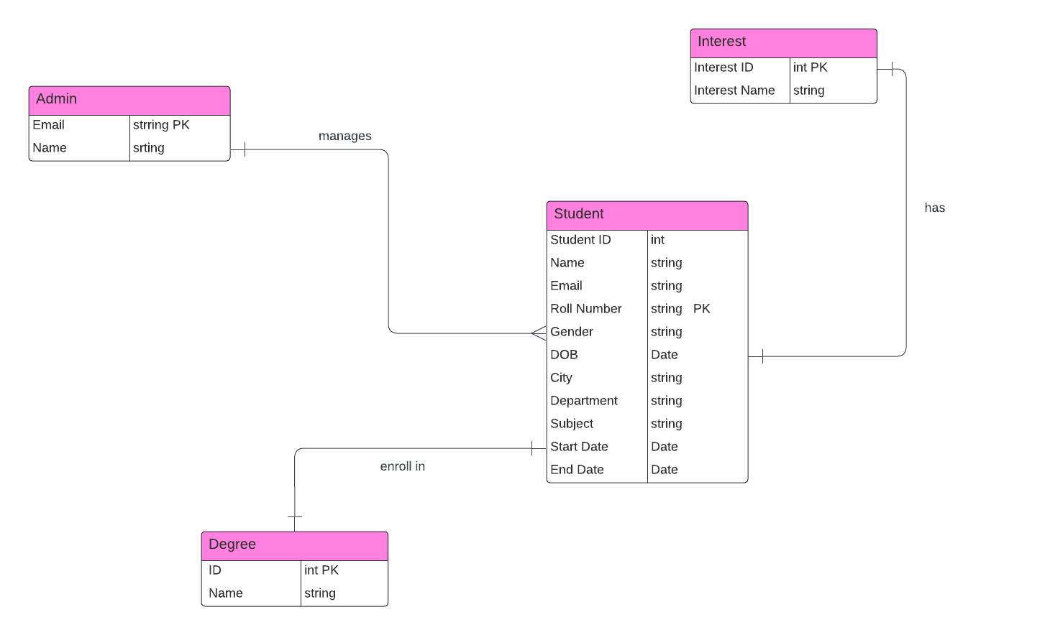
Entity Relation Diagram

Slide 3

Application Flow
At first login form for admin login
As he/she login go to next page
Where can add student by filling student form
After adding student click on add student button, student is added in database
On navbar there are 4 option mean from where user can add student, see dashboard, see added student list and logout.
Now to see added student click on Student list where student data show in a manageable table form
In front of each student row 3 actions show VIEW,EDIT,DELETE

Slide 4
Application Flow
On clicking on view added student details shows.
On clicking on edit ,edit foorm open where you caan edit any field of your choice.
On clicking on delete you can delete that row.
If you go on dashboard here different statistics shows grphs and pi charts showing student analytics.
After doing all these things if you wanna leave website here is logout button on clicking on it admin can logout.

Slide 5
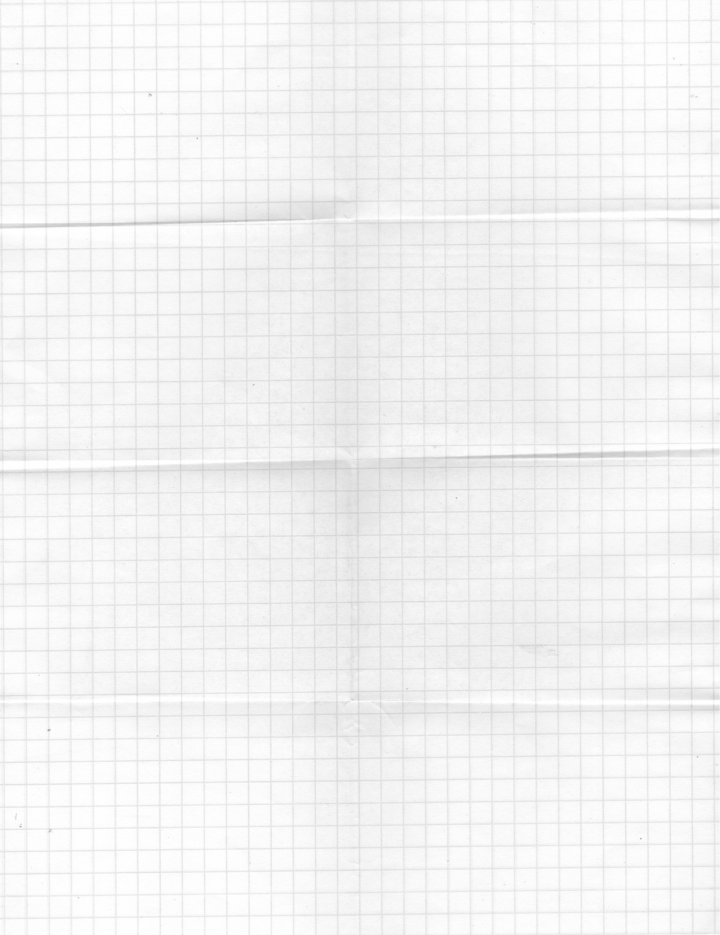



Technologies Used
React (Frontend):
Declarative UI for easier code comprehension.
Component-based architecture for code reusability.
Large ecosystem and active community support.
Node.js:
Single-language (JavaScript) for both frontend and
backend.
Non-blocking I/O for scalability and efficiency.
Fast execution with the V8 JavaScript engine.

Slide 6
Technologies Used
MongoDB (Database):
Flexible schema design for evolving data structures.
Scalability through horizontal scaling and sharding.
JSON-like documents for easy integration with JavaScript.
Developer-friendly query language and document-oriented
model.

Slide 7

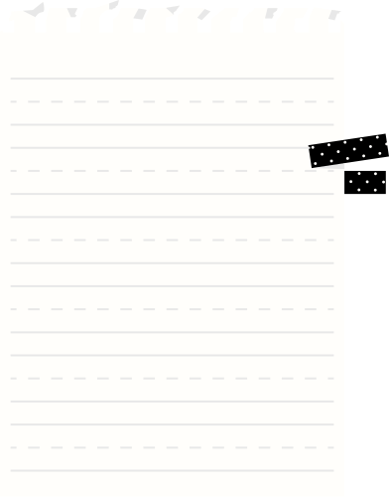
Fonts used
Roboto:
Digital Optimized
Variety of Styles Support
Consistent Across Platforms
Sans-serif:
Clean and Modern
Quick Loading
Timeless Appeal
Ease of Reading
Color Schemas
I use pink purple and white color theme for my project.
Because it looks good and suitable for my webpage.
Template used
Slightly changed by provided by sir.

Slide 8


THANK YOU

